Slide 1
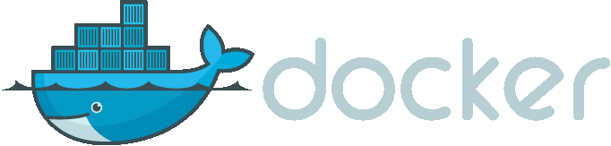
Tom Bendrath
2017-06-08

Slide 2
Agenda
Docker History
What is Docker?
Containers vs. VMs
How Docker solves all the problems?
Hands-on Workshop

Slide 3
Docker History
Founded in 2009
Formerly dotCloud Inc.
March 2013:
„Docker“ is shown to a public audience for the first time
Apache 2.0 license (open source)
March 2014:
JAX Innovation Award (most innovative open technology)
June 2016: Native Integration into Windows and OS X
Today:
One of the most starred projects on Github
~ 300k public repositories on hub.docker.com
Main contributors: Docker Team, Cisco, Google, Huawei, IBM, Microsoft
Notes:
Docker Team: Hires maintainers and contributors, Provides Project-Infrastructure, Runs Docker Hub

Slide 4
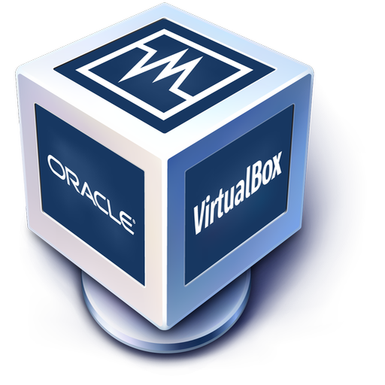

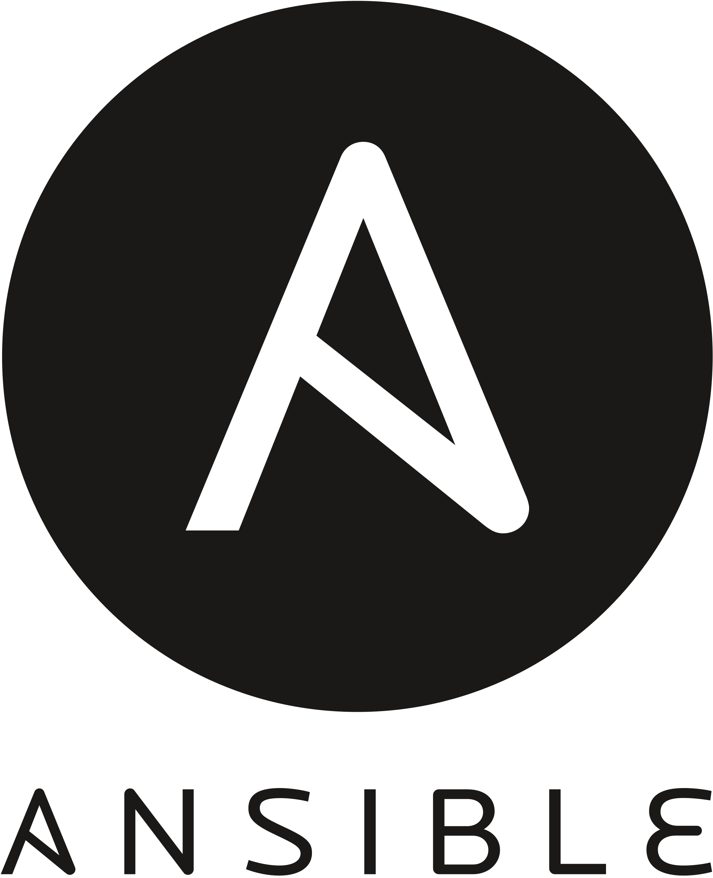

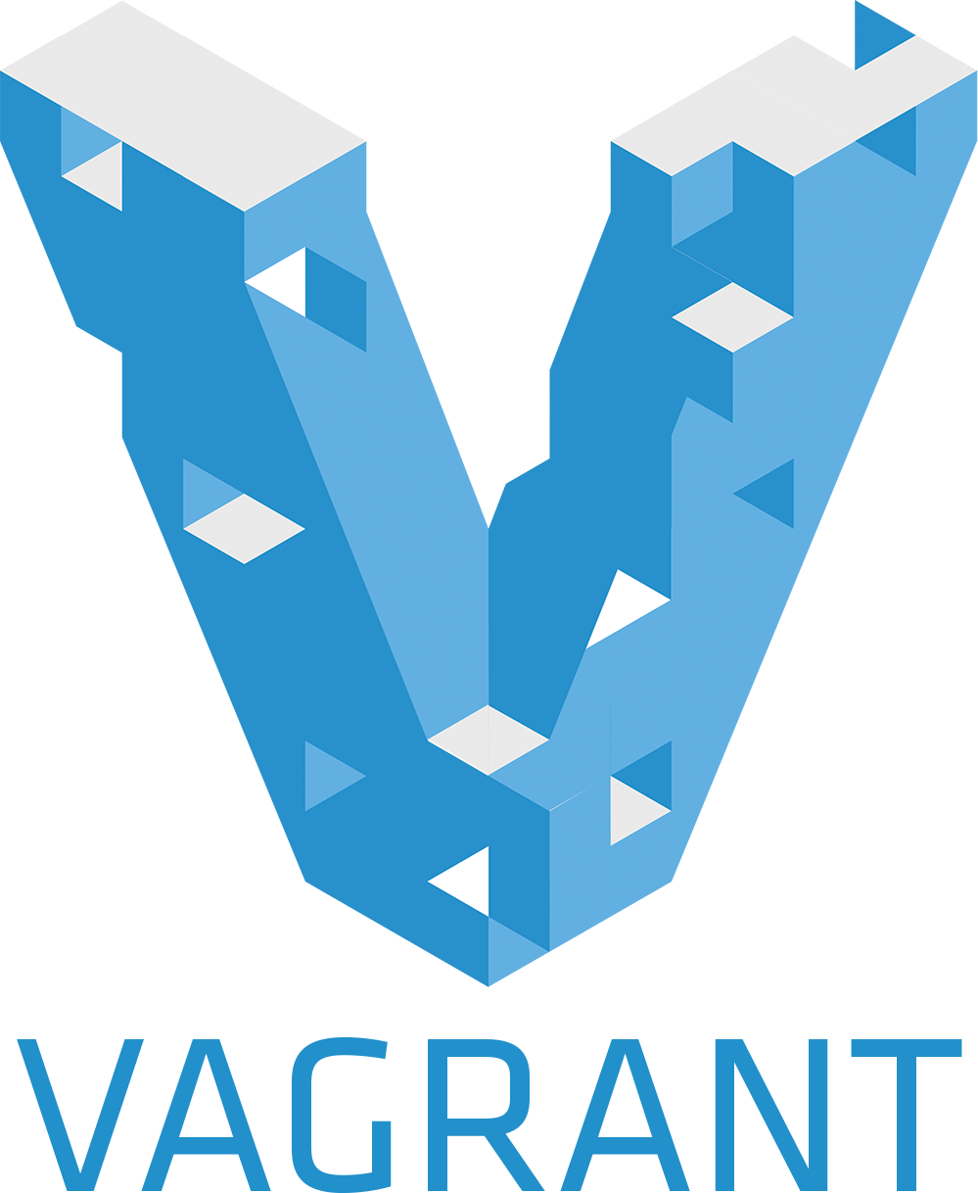
What is Docker?
Virtualization tool?
Configuration manager?
VM manager?
cgroups?
LXC?
libvirt?
go?

Slide 5
Docker.com says Docker is an open platform for developers and sysadmins to build,ship, and run distributed applications
Docker Engine
A portable, lightweight runtime and packaging tool
Docker Hub
A cloud service for sharing applications and automating workflows
Notes:
The truth is, Docker is in a category to itself.
Engine: This is what actually powers Docker on your local development environment. Hub: The Docker hub is a central registry where everyone shares their Docker images.

Slide 6
What is Docker?
Less portable, minimal overhead
Most portable, lots of overhead
CM tools
Docker
Manual configuration
Traditional VMs
Notes:
These applications can be configured once and run in any environment.
MC: You SSH into that box. You have shell access on that box. And you manually install everything you need to run your application.
This approach has the benefit of being very simple and straightforward, but you can't take it to any other server without having to repeat all the same effort.
CM: These tools allow you to codify the desired state of your server in their own configuration language.
VM: It has complete isolation from its host environment. Emulating hardware for GOS, large file size
Docker offers most of the isolation benefits of traditional virtual machines without the overhead of running a guest operating system.

Slide 7

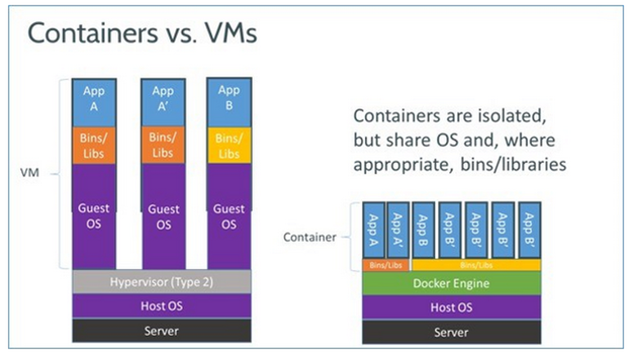
Notes:
VM: Architecture + deploy with VM This approach benefits for maximum isolation, but isn't very efficient. Ultimately, the server hardware has to power the hypervisor layer itself and the guest operating system just to run your application.
You'll notice that we can even share binaries and libraries across two running instances of the same application. This is what makes Docker so powerful. It provides most of the isolation benefits of traditional virtual machines without the overhead of running a guest operating system and a hypervisor. This allows you to have software applications that are packaged in Docker containers that you can be confident will behave the same way in development and production but are still lightweight enough to move around easily and to start and stop quickly.

Slide 8
How Docker Solves All The Problems

Slide 9
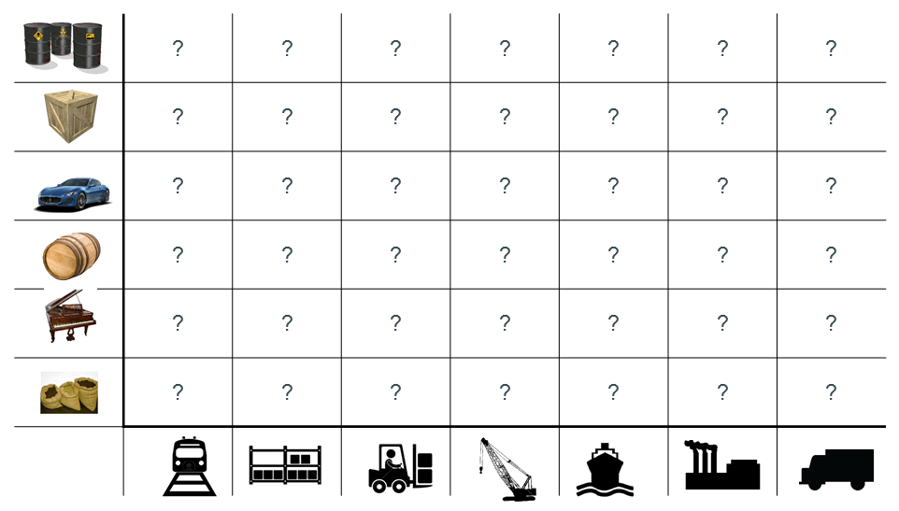
Docker Containers - Shipping Matrix From Hell

Slide 10
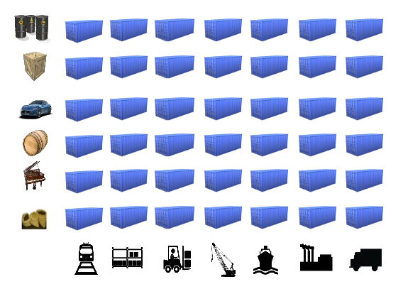
Docker Containers - Standard Shipping Container
Notes:
A standard container that is loaded with virtually any goods, and stays sealed until it reaches final delivery.
In between, can be loaded and unloaded, stacked, transported efficiently over long distances, and transferred from one mode of transport to another.

Slide 11
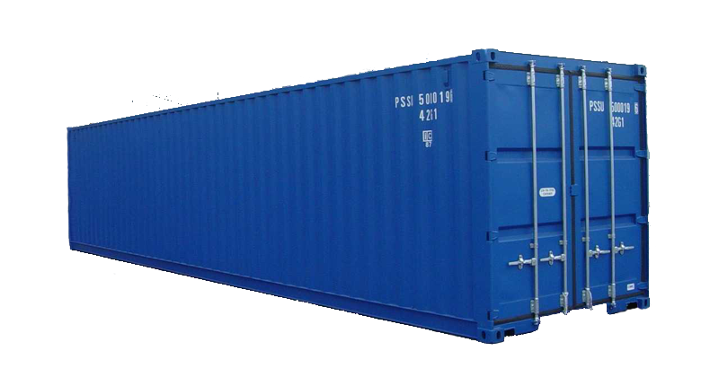
What’s Inside Doesn’t Matter
Notes:
An engine that enables any payload to be encapsulated as a lightweight, portable, self-sufficient container that can be manipulated using standard operations and run consistently on virtually any hardware platform.

Slide 12
Docker benefits
Fast ( deployment, migration, restarts)
Secure
Lightweight (save disk & CPU)
Open Source
Portable Software
Microservices and integrations (APIs)
Simplify DevOps
Version control capabilities

Slide 13
Useful Links
Awesome Docker (list of Docker resources & projects)
Docker cheat sheet
Docker shortcuts
Docker case studies

Slide 14
Questions?

